Slide 1
NSE Stock Exchange Analysis using Big Data
Aditya Shethiya 1034791
Akhil balla

Slide 2


What IS NSE AND HOW WE USE BIG DATA FOR THE ANYLISIS
From last two-decade internet base technologies like web technologies affects lot on Indian stock exchange and use of internet break the barrier between broker and investor and location
There are more than 300 companies are there in stock market
we need to analyze the stock like which one is best for short term (trading)investment.
More than 3 gb of data is generated in less than 1 week that’s the resoan behing using of big data

Slide 3

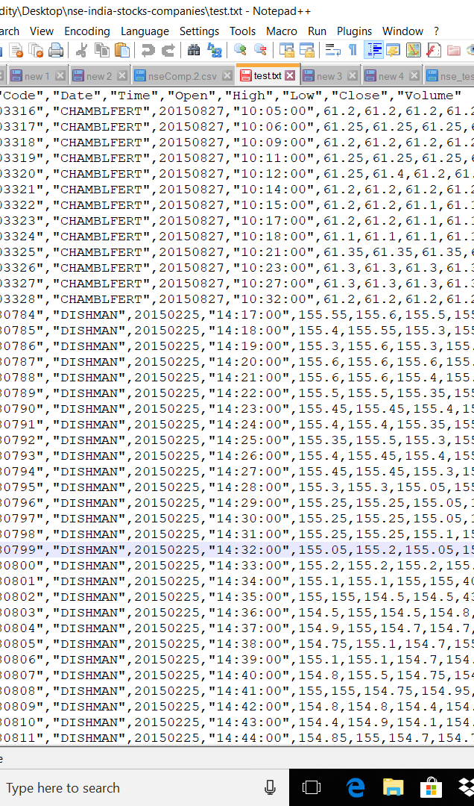
Cleaned database Of Nse
company code : it is special identifier for the company that we use it as primary key.
Name of the company
Date and time
open stock prize
High, Low index prize on that day
Close: closing prize of the stock
Volume: total number of available shares on that day

Slide 4
Technologies that used for anylisis
Map reducing
Hive
Pig
Spark
Big Query
Google studio

Slide 5
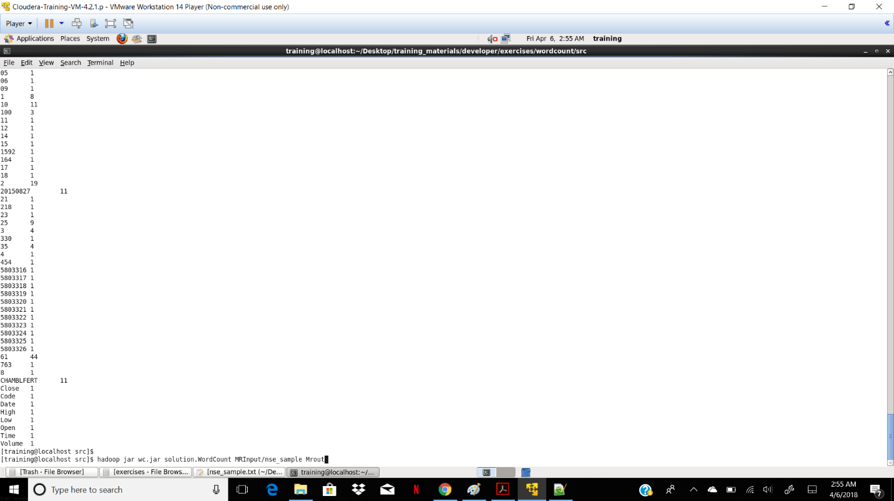
Map Reducing
In Map Reducing We Take Each Record as key and then we count its total number which are present in the given file.

Slide 6
Hive
In hive first we save our csv file on hdfs file location then we put that data in new hive table and then we calculate folling terms
Return:(close prize-open prize)/open prize
Prcent return:((close prize-open prize)open prize)*100
Adjusted prize 1:sum(close prize)-(count(close prize)*5)
Adjusted prize 2: sum(close)*0.5
Total number of share that company owned:sum(volume)/count(volume)*0.5

Slide 7
Continued….
Stocks Free For Share Holder: sum(volume)/count(volume)*0.49
Average stock value: ((sum(open)/count(open))+(sum(close)/count(close)))*0.5
Turn Over Ratio:(sum(high)/count(high))/((sum(open)/count(open))+(sum(close)/count(close)))*0.5

Slide 8
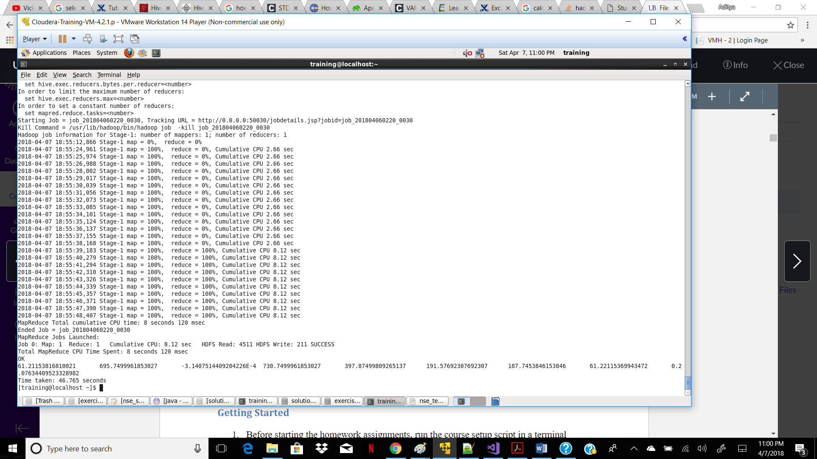
HIVE output:

Slide 9
Big Query
First we save our data at cloud storage
Then we pull all that data in big query table
Then we calculate the standard deviation of the of the give data

Slide 10

Pig
First we save all our data on Hdfs then we calculate the change
And gain or lose of the stock if present difference between close prize and open prize is grater than zero then gain otherwise loss
Query:
A = LOAD '/home/training/Desktop/nse_test_data.csv' USING PigStorage(',');
B = FOREACH A GENERATE $0 AS ID,$1 AS COMPANY_NAME,$2 AS DATE,$3 AS TIME,$4 AS OPEN, $5 AS HIGH,$6 AS LOW,$7 AS CLOSE,$8 AS VOLUME,((($7-$4)/$4)*100) AS CHANGE,(((($7-$4)/$4)*100)>0?'G':'L') AS GAINLOSS;
C = GROUP B BY COMPANY_NAME;
D = FOREACH C GENERATE B.COMPANY_NAME,AVG(B.CHANGE);
STORE D INTO '/home/training/pig/OUTPUT' USING PigStorage();

Slide 11
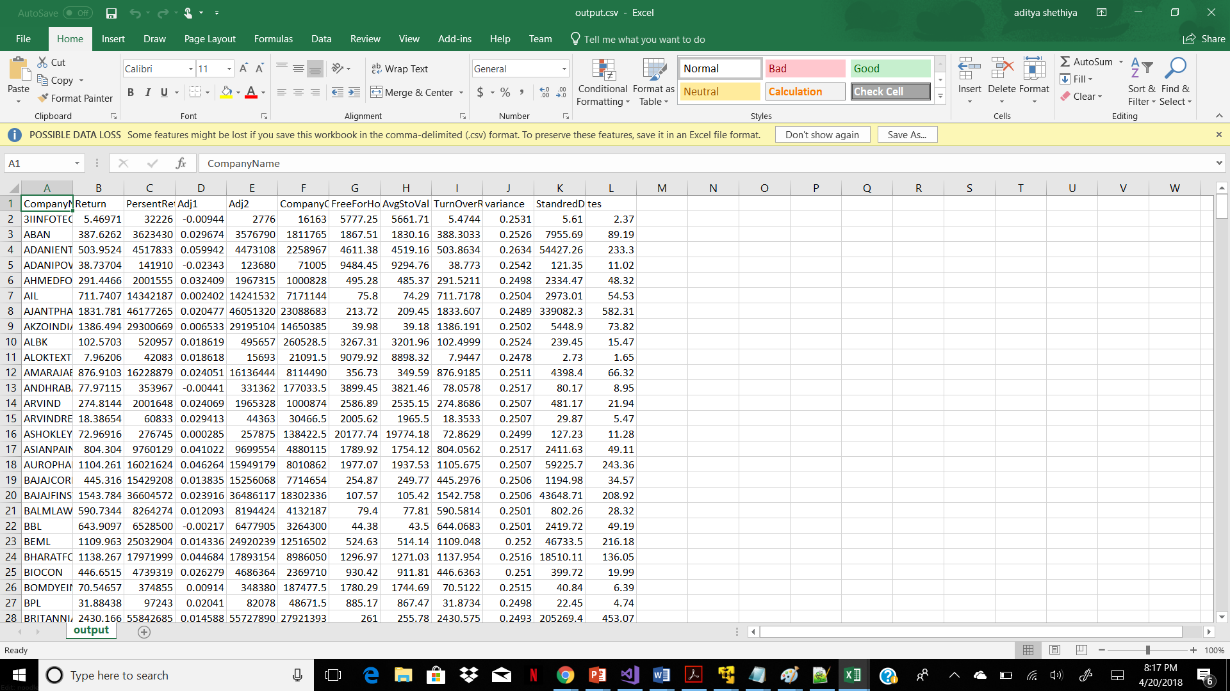
Final Output Screenshot:

Slide 12
Visualization of the output:
For the visualization of the output we use google studio tool which present on gcp
In this tool we can create pie chat, graphs from our data
Link where shared n access this data
https://datastudio.google.com/u/0/reporting/1-1-aclWhD8_b4uauW4WOVuZWT34cwhO7/page/supQ/edit

Slide 13
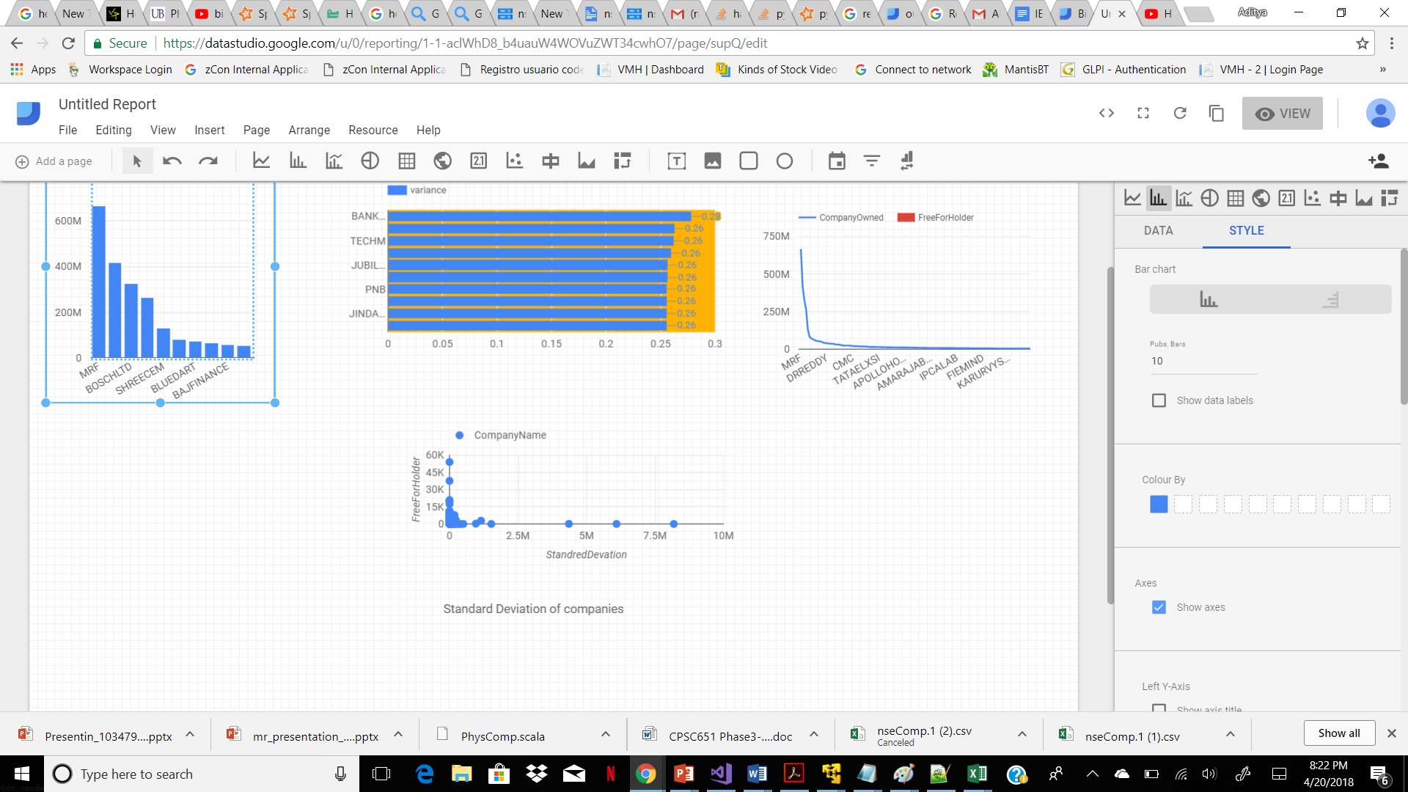
Output:

